Slide 1


My Autobiography
Mark Mwangi
C025-01-0654/2020

Slide 2
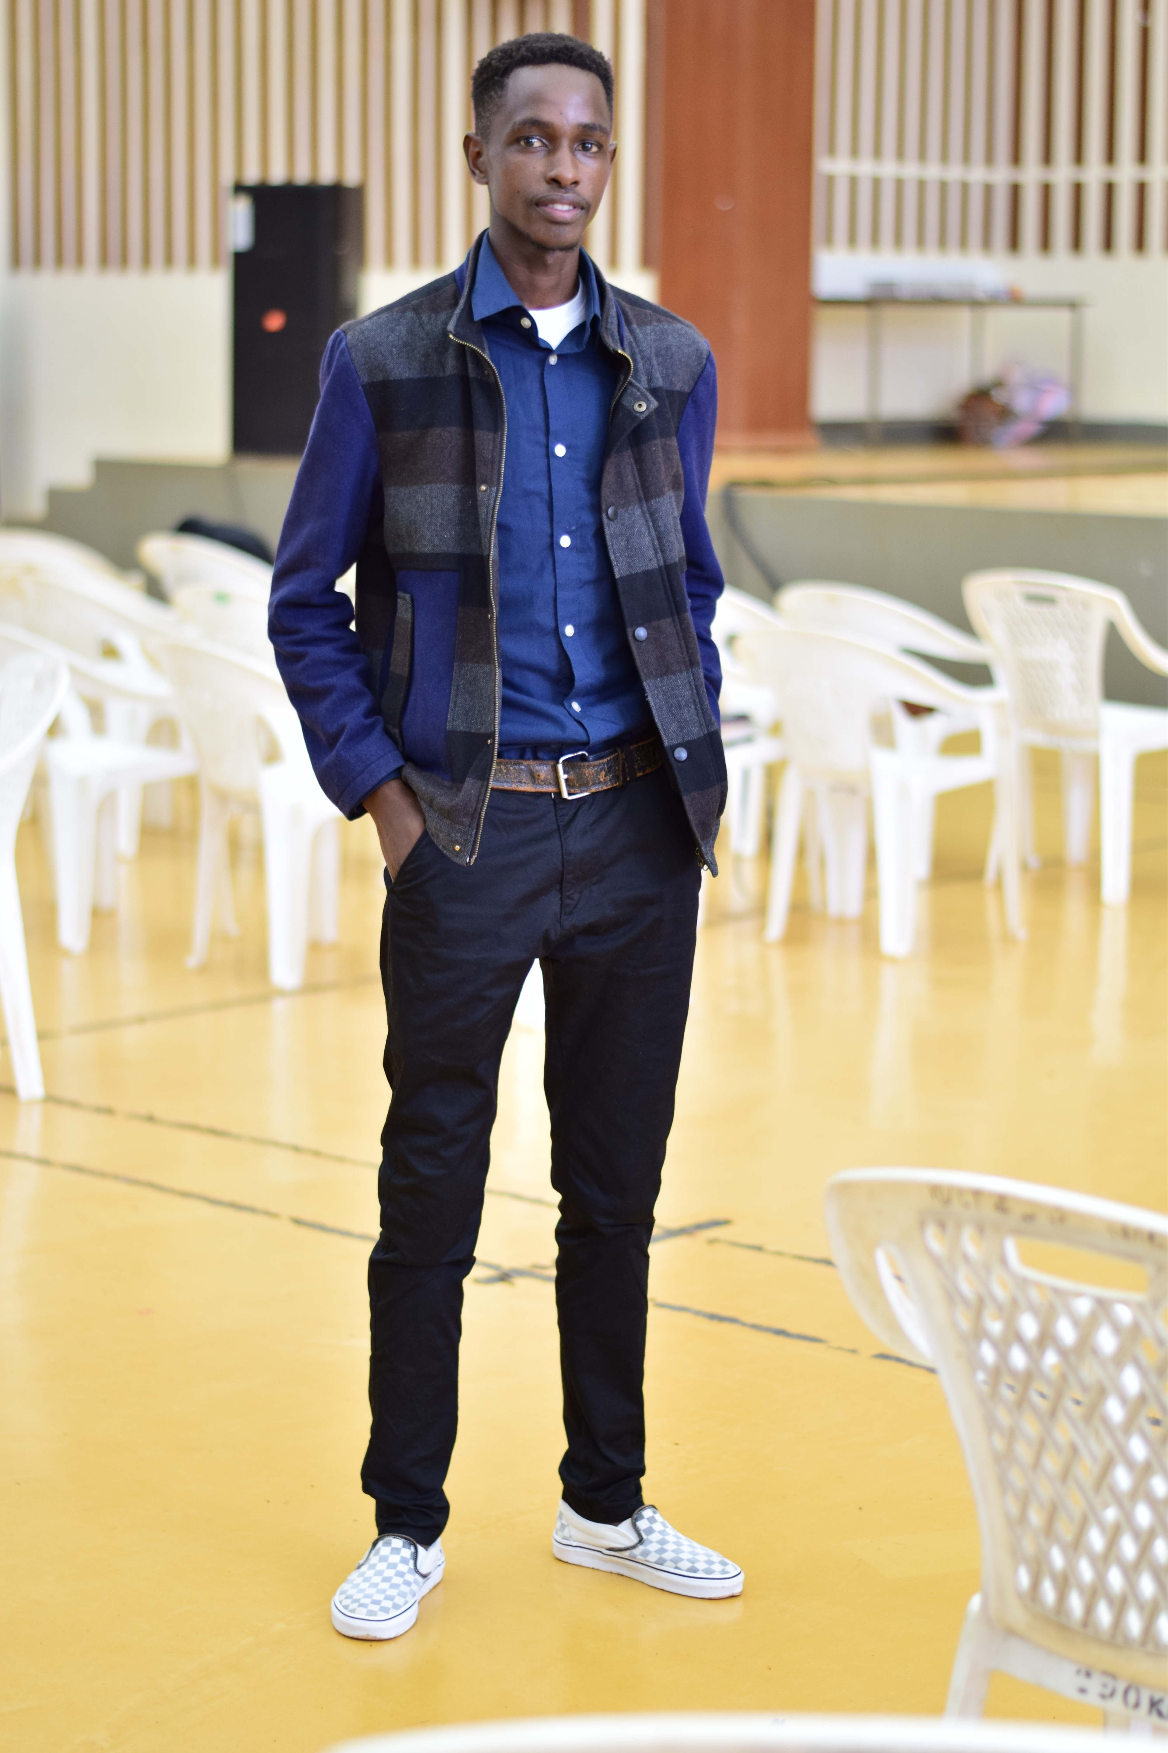
Personal Information
Mark Mwangi
Software Developer
Student
An Ambitious and Principled boy
02 April 2024

Slide 3


Introduction
My name is Mark Kamau Mwangi and I am delighted to embark on the journey of sharing my life story with you through this autobiography. Born and raised in Bungoma in Webuye District Hospital then referred to u Bungoma County Hospital, I come from humble beginnings that have significantly influenced the person I am today

Slide 4
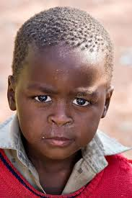
Early Child hood
My childhood was defined by the guiding hand of my parents, who instilled in me a set of values and virtues that would shape my character for years to come. Growing up in a household where discipline and responsibility were non-negotiable,
I learned early on the importance of respect, integrity, and diligence. While my parents' strictness sometimes felt overwhelming, it was rooted in their deep commitment to raising principled individuals capable of navigating life's challenges with grace and resilience

Slide 5
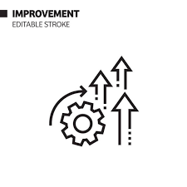
Discovering My Spark
I've always been drawn to creativity from a young age.
Whether it was finger painting as a toddler, building elaborate Lego creations, I found joy in expressing myself, bringing ideas to life.
This early love for e.g., art, building things would later develop into mention your current creative passion - e.g., painting landscapes, designing robots.

Slide 6

Academics
Primary Education: I attended Webuye S.A where I developed a strong foundation in [subjects of interest].
Secondary Education: My high school years were spent St Peters Mumias], where I excelled in subjects such as [mention subjects].
Higher Education: Upon graduation, I pursued Degree at Dedan Kimathi University Here, I delved deeper into Information Technology and honed my skills in Soft ware development .

Slide 7

Professional Exeperience
Internship: I kickstarted my career with an internship at [The Jitu software company where I gained hands-on experience in Web application and developments.
Entry-Level Role: Following my internship, I transitioned into an entry-level position at [Safaricom Plc ], where I contributed solving problems through creation of IOT devices .
Career Growth: Over the years, I've taken on increasingly challenging roles, including Project Manager at cyber sec Company , where I've demonstrated my expertise in Mobile and web development .

Slide 8

Key Achievements .
Project Success: Led a team in the successful completion of a church application project, resulting in a good communication and interaction of church members in an application .
Recognition: Received Certificate in Full stack development for outstanding performance in web development .
Contributions: Made significant contributions to problem solving in my university hostels, resulting in efficient way to manage university hostels.
Skills Development: Continuously enhanced skills software development and data analyst through training and professional development opportunities.

Slide 9

Hobbies
Photography: Capturing moments and exploring different perspectives through the lens.
Traveling: Exploring new cultures, cuisines, and landscapes around the world.
Reading: Diving into various genres of literature, from fiction to self-improvement.
Outdoor Activities: Hiking, camping, and enjoying nature's beauty.
Cooking: Experimenting with recipes and flavors to create delicious meals.
Gardening: Nurturing plants and cultivating green spaces for relaxation.
Sports: Engaging in physical activities like swimming, tennis, and cycling for fitness and fun.
Volunteering: Giving back to the community through charitable activities and initiatives.

Slide 10

My Future Goals
Career Advancement: Striving for professional growth and development in my field, aiming for leadership roles and innovative projects.
Education: Pursuing further studies or certifications to expand my knowledge and skills, staying updated with emerging technologies and trends.
Personal Growth: Continuously striving for self-improvement, maintaining a healthy work-life balance, and prioritizing mental and physical well-being.

Slide 11

Appreciation
Family Support: Grateful for unwavering support.
Mentors/Teachers: Appreciation for guidance and wisdom.
Colleagues/Peers: Thankful for collaboration and camaraderie.
Friends: Deep gratitude for friendship and support.
Opportunities: Thankful for learning and growth.

Slide 12

.
As I reflect my past and keenly on my present, it gives me an outline and a kind prediction of my future . One thing I have learned is that Our past does not necessaryly influence our future but our presence gives us a glimpse of the future .

